Slide 1



Functional Verification of OpenHMC
Supervisor: Dr. Ibrahim Qamar
Sponsor: Si-vision
Team Members:
Alaa Rabie
Ali Maher
Mahmoud Mousa
Mohamed Ahmed
Mohamed Hosam
Nada Othman
Rahma Hamdy

Slide 2
Content
1- Introduction
2- HMC Architecture & Specs
3- RTL design
4- Verification Plan
5- Testbench Architecture
6- RF Agent
7- AXI Agent
8- HMC Agent
9- Scoreboard
10- Coverage
11- Simulation & Results
12- Conclusion

Slide 3
Content
1- Introduction
2- HMC Architecture & Specs
3- RTL design
4- Verification Plan
5- Testbench Architecture
6- RF Agent
7- AXI Agent
8- HMC Agent
9- Scoreboard
10- Coverage
11- Simulation & Results
12- Conclusion

Slide 4
Functional Verification
1- Introduction
1/12
We need to understand the following points
role and position of functional verification in the cycle of digital IC design flow.
also understand why the HDL language “Verilog” isn’t enough for current requirements of verification of complex designs
why people moved to a new hardware verification language called “SystemVerilog” to build testbenches.

Slide 5
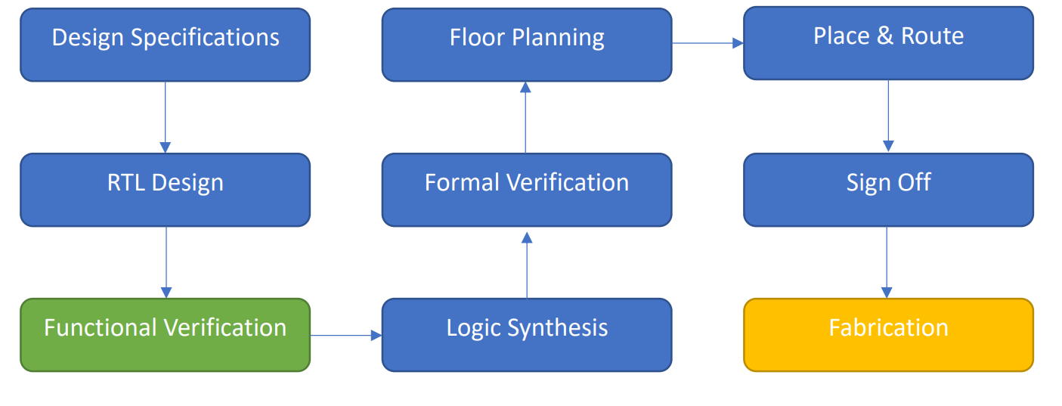
ASIC Digital Design Flow
1- Introduction
1/12
It can be best explained by a flowchart of the typical steps needed for the fabrication of an IC as shown.

Slide 6
As design complexity increases, better tools are needed which lead to moving to SystemVerilog which is basically Verilog with some added features.
1- Introduction
1/12
Why systemveriolg instead of verilog ?
Compatible with Object-Oriented Programming
New data types simplify generating and checking stimulus
Coverage
Transaction level modeling

Slide 7
Advantages of building verification environment
1- Introduction
1/12
The Verification Engineer builds the verification environment to test the functionality of the design.
To make sure the RTL meets all the specs.
By simulating multiple test cases and reporting functional coverage once the first version of the RTL is ready.
If either a bug is found or the design not achieving a spec then report back to design engineer.

Slide 8
Advantages of Discovering bugs at early stage
1- Introduction
1/12
Discovering any bugs before heading into the synthesis and the backend implementation of the IC is very benefitable for multiple reasons, some of them are.
Easier to find the error and fix the bug.
saving time and money of repeating the flow of fabrication.
Less bugs that end in the hands of the consumer.

Slide 9
The Goal of Functional Verification
1- Introduction
1/12
no design can be entirely bug free for all scenarios, so verification goal is not to prove that the design is bug-free
the process of chip fabrication is very time consuming and costs millions due to designs’ complexity
So discovering any defects at early stage saves time and cost
our focus is about to make sure the design can accomplish its task successfully according to specifications.

Slide 10
The Features of UVM
1- Introduction
1/12
Universal verification methodology (UVM) is a standard to enable faster development and reuse of verification environments and verification IP throughout the industry.
It’s a library of basic open-source classes we don’t have to know everything about but just include it and extend from it while writing our testbench.

Slide 11
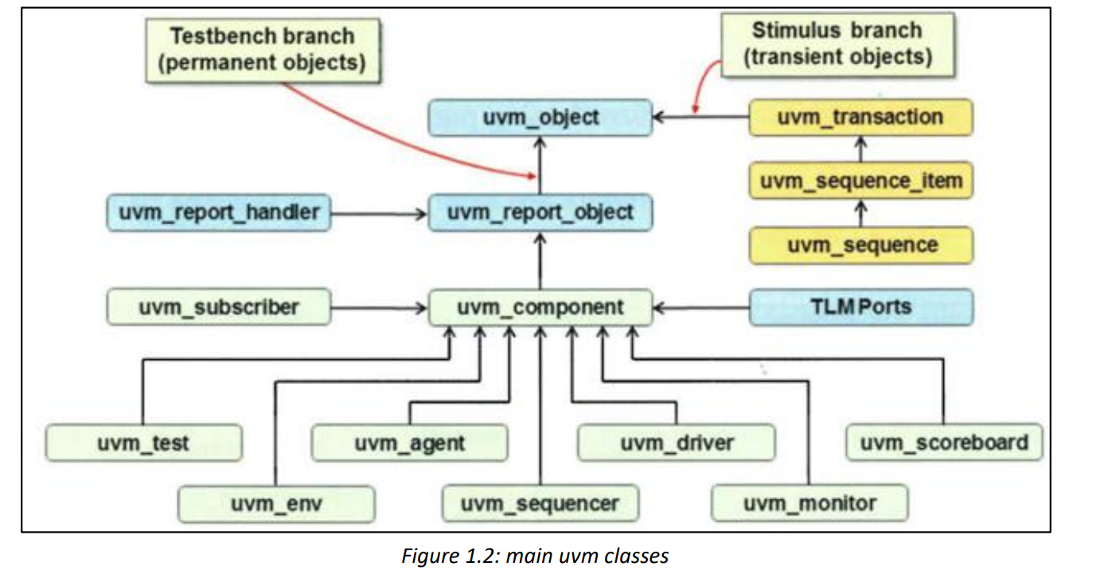
Some of the built-in UVM classes is shown
1- Introduction
1/12

Slide 12
Goals of the project
1- Introduction
1/12
Our goal at the end of this project is to build a UVM verification environment for OpenHMC controller RTL design.

Slide 13
Project Objectives are:
1- Introduction
1/12
Learn Verilog and SystemVerilog programming languages.
Learn OOP.
Understand basic and advanced verification skills and flow.
Developing codes of a UVM environment.
Learn how to read a specification file.
Learn how to read user manual of a simulation tool.

Slide 14
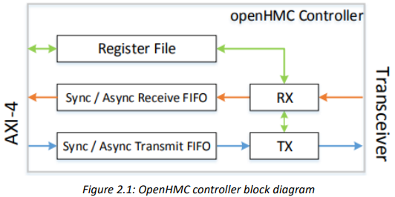
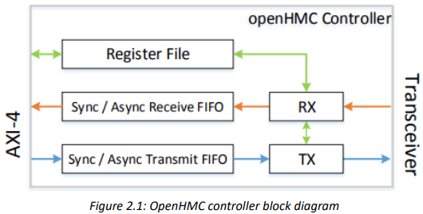
What’s OpenHMC?
1- Introduction
3/12
Features.
Supported Confugurations.

Slide 15
Content
1- Introduction
2- HMC Architecture & Specs
3- RTL design
4- Verification Plan
5- Testbench Architecture
6- RF Agent
7- AXI Agent
8- HMC Agent
9- Scoreboard
10- Coverage
11- Simulation & Results
12- Conclusion

Slide 16
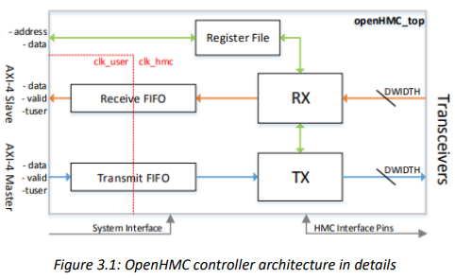
Interfaces, pins and configuration parameters
2-HMC Architecture & Specs
2/12

Slide 17
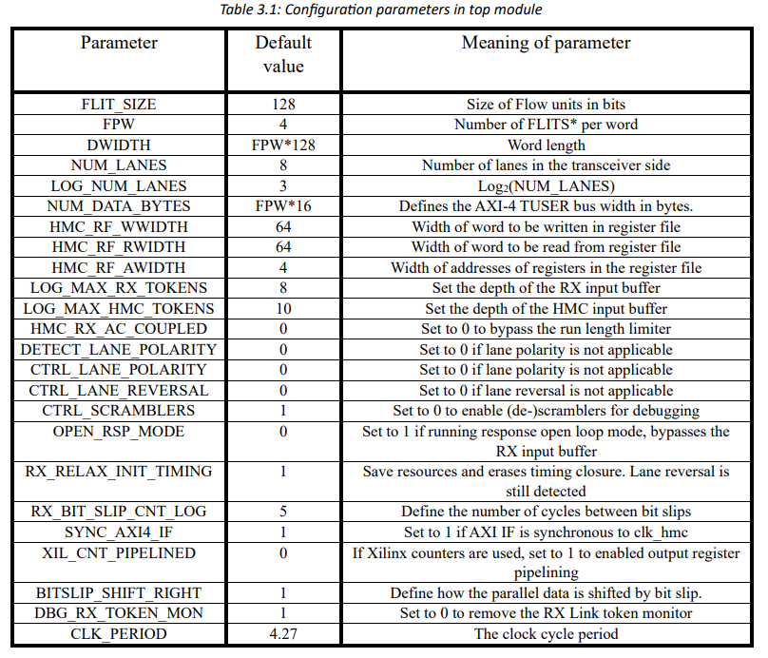
Configuration parameters
2-HMC Architecture & Specs
2/12

Slide 18
Interfaces and Pins
2-HMC Architecture & Specs
2/12
AXI
HMC Physical Layer (transceiver) interface
System Interface
HMC Interface
Register File Interface
We ’ve 5 interfaces:
Interfaces

Slide 19
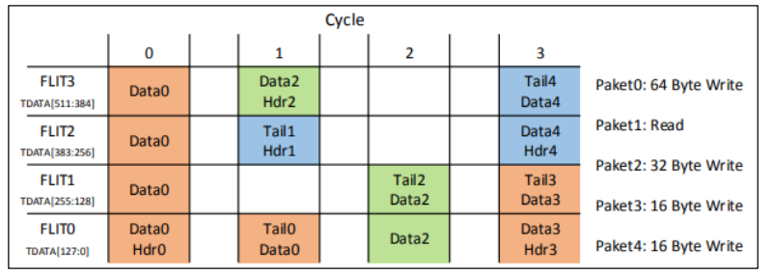
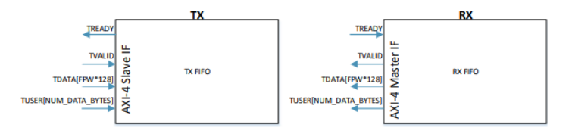
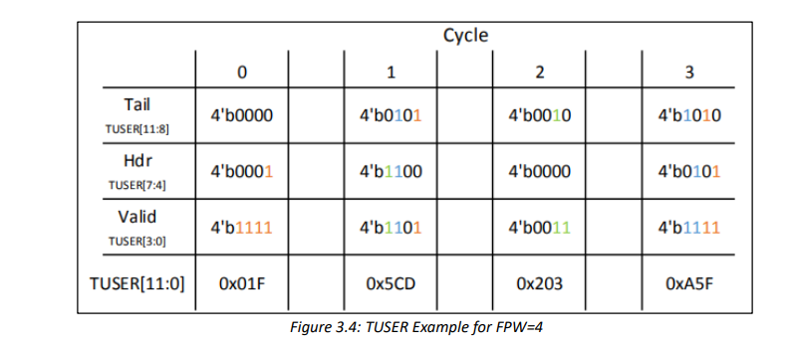
AXI Interface
2-HMC Architecture & Specs
2/12
AXI-Interface Pins
TVALID [1 bit]
TDATA [FPW*FLIT_SIZE]
TUSER [NUM_DATA_BYTES bit]
TREADY [1 bit]
What’s AXI ?

Slide 20
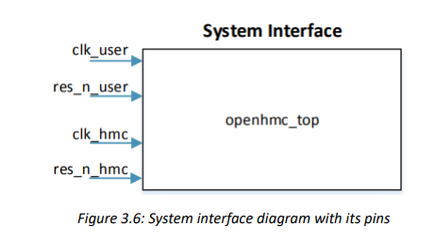
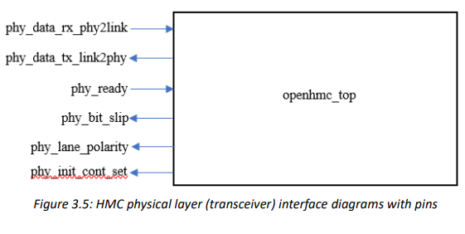
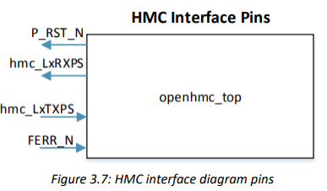
Other Interfaces
2-HMC Architecture & Specs
2/12
HMC Physical Layer (transceiver)
Interface.
System Interface.
HMC Interface.

Slide 21
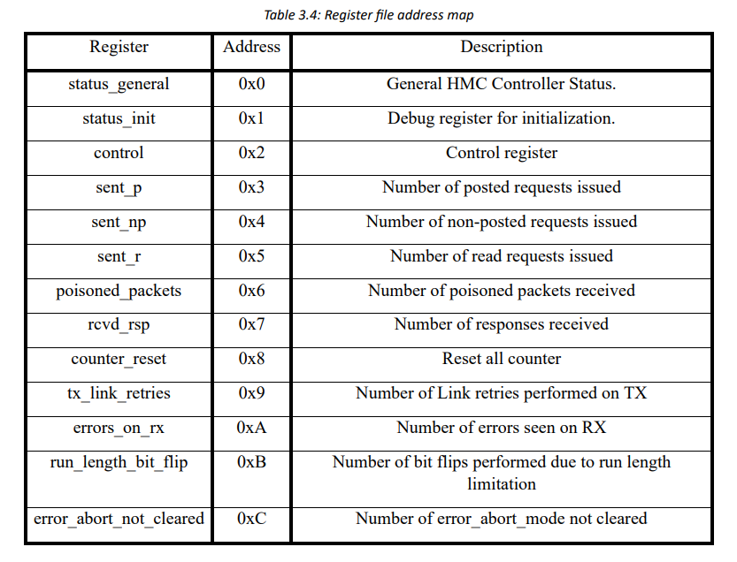
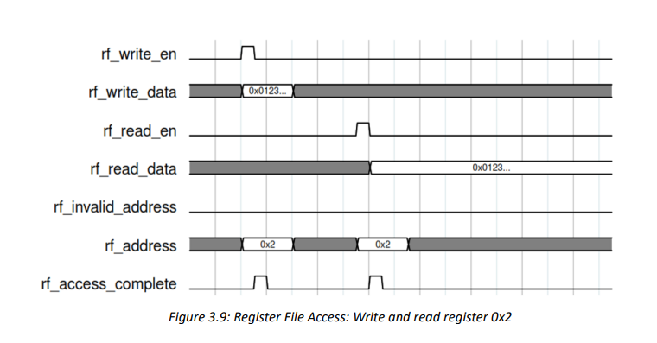
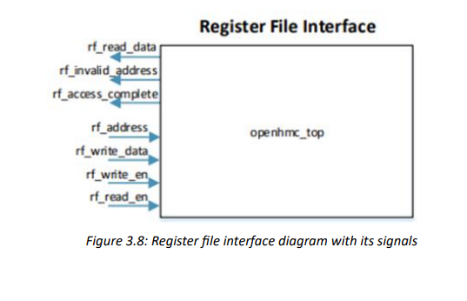
Register File Interface
2-HMC Architecture & Specs
2/12
What’s its usage?
How to get data from it?
Its contents and address
map.

Slide 22
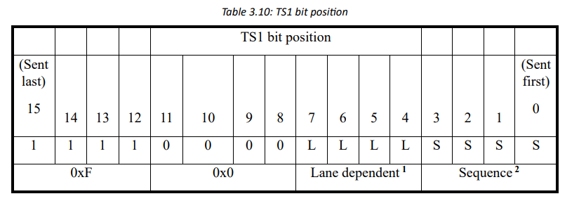
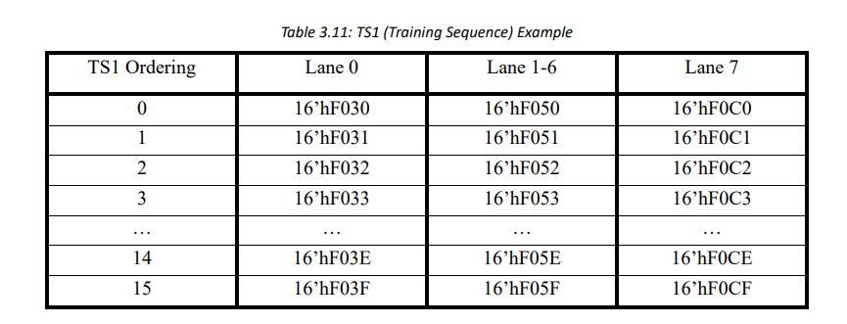
TS1 (Training Sequence)
2-HMC Architecture & Specs
2/12

Slide 23
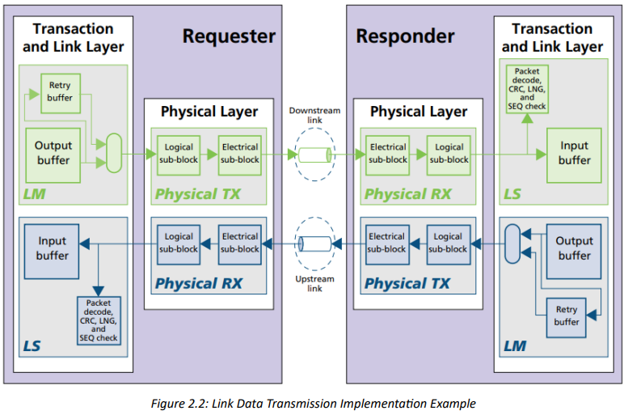
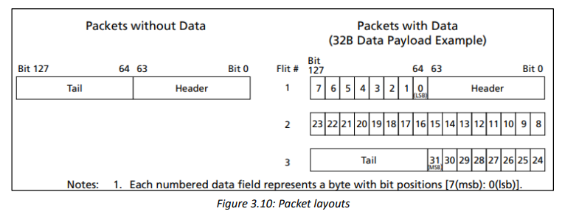
Transaction and Link Layers
2-HMC Architecture & Specs
2/12
Difference between Transaction
and Link layers.
What are Flow packets?
Transaction layer packets.

Slide 24
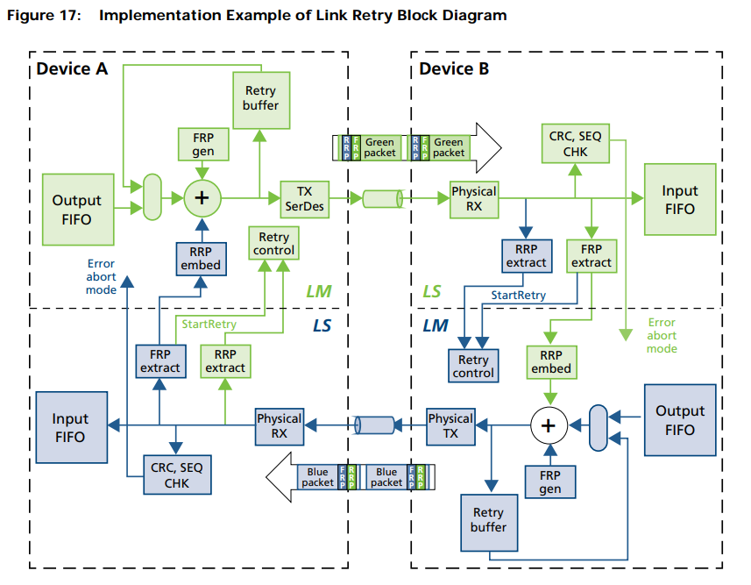
Link Retry
2-HMC Architecture & Specs
2/12
When is it triggered?
Retry Buffer.
Forward Retry Pointer (FRP).
Return Retry Pointer (RRP).
RETRY POINTER RETURN (PRET) packet.

Slide 25
Transaction layer: Packet Flow Control
2-HMC Architecture & Specs
2/12
What’s it?
How is it managed? (TRET)

Slide 26
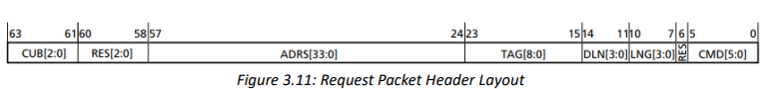
Transaction layer: Request Packets
2-HMC Architecture & Specs
2/12
Request Header Layout.
Request Tail Layout.

Slide 27
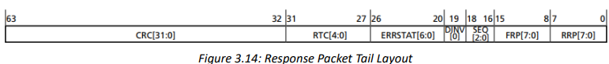
Transaction layer: Response Packets
2-HMC Architecture & Specs
2/12
Response Header Layout.
Response Tail Layout.

Slide 28
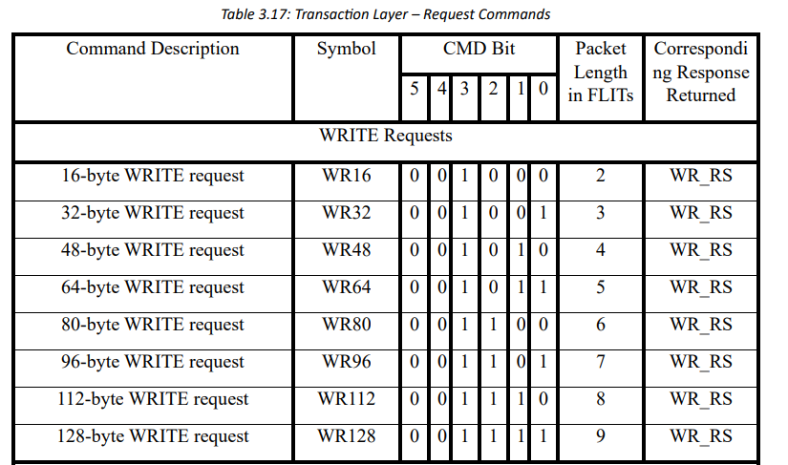
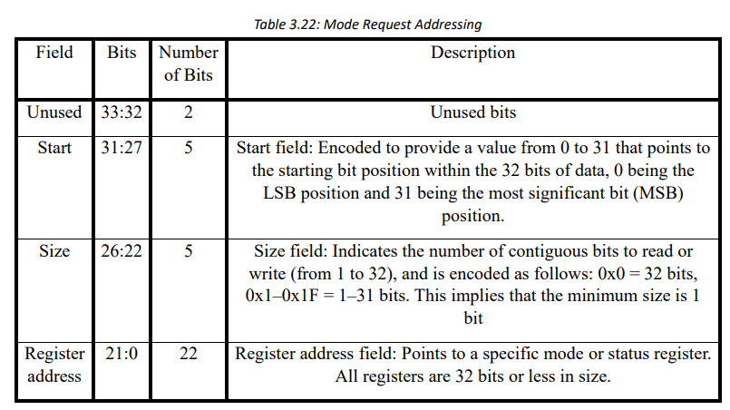
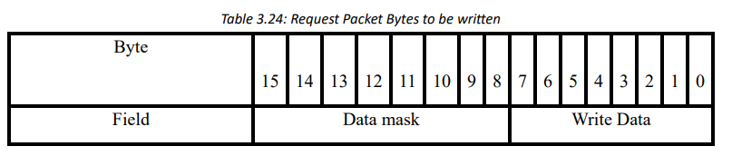
Transaction layer: Request Commands
2-HMC Architecture & Specs
2/12
READ and WRITE Request Commands.
POSTED WRITE Request Commands.
MODE READ and WRITE Request Commands .
BIT WRITE Command.

Slide 29
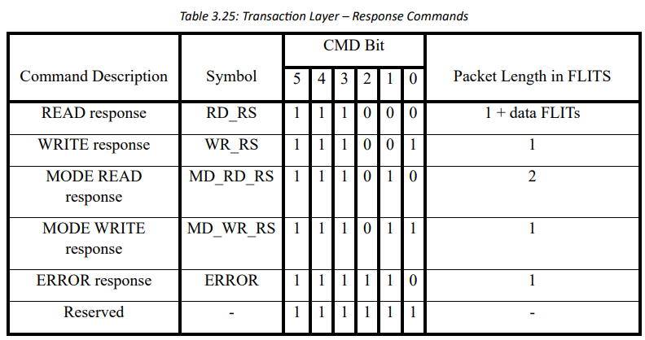
Transaction layer: Response Commands
2-HMC Architecture & Specs
2/12
READ and MODE READ Response Commands.
WRITE and MODE WRITE Response Commands.
ERROR Response Command .

Slide 30
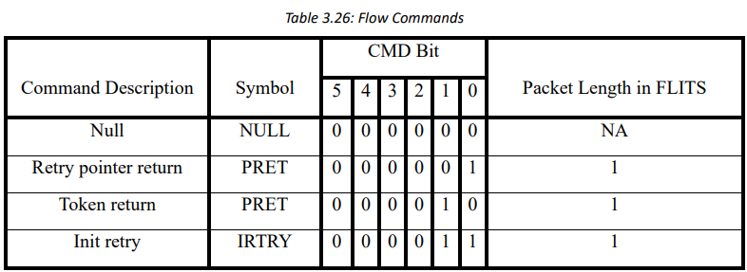
Link layer: Flow Commands
2-HMC Architecture & Specs
2/12
NULL Command.
RETRY POINTER RETURN (PRET) Command.
TOKEN RETURN (TRET) Command.
INIT RETRY (IRTRY) Command.

Slide 31
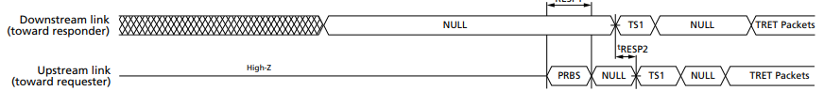
Transaction Layer Initialization
2-HMC Architecture & Specs
2/12
/12
NULL FLITs.
TS1 patterns.
NULL FLITs.
TRET packets.
Request/Response packets.

Slide 32
Content
1- Introduction
2- HMC Architecture & Specs
3- RTL design
4- Verification Plan
5- Testbench Architecture
6- RF Agent
7- AXI Agent
8- HMC Agent
9- Scoreboard
10- Coverage
11- Simulation & Results
12- Conclusion

Slide 33
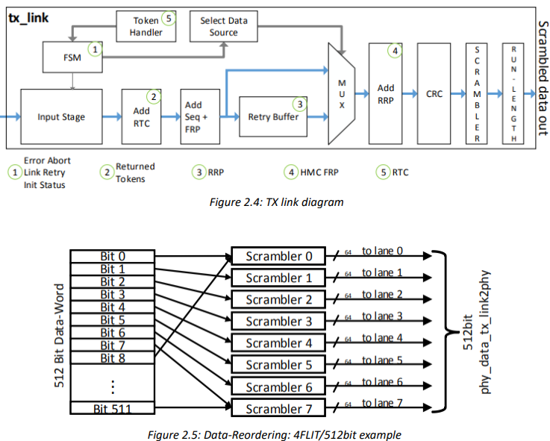
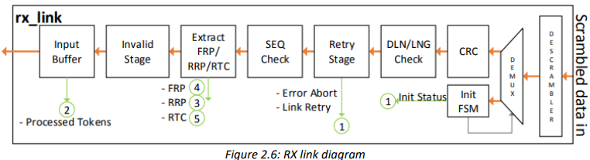
Module Description
3- RTL design
3/12
Transmit and Receive FIFOs.
TX Link (tx_link.v).
RX Link (rx_link.v).
Register File (openhmc_rf.v).
Header File.
Top Module (openhmc_top.v).

Slide 34
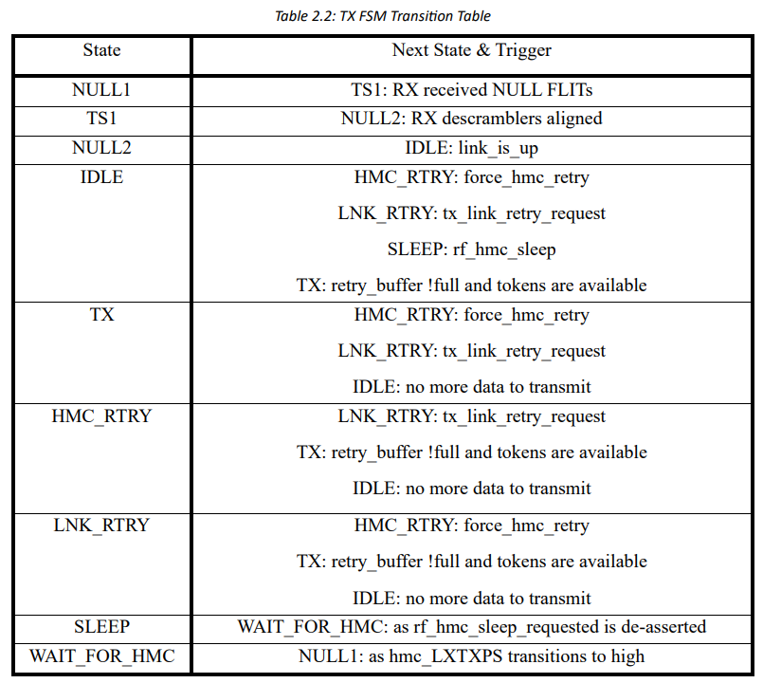
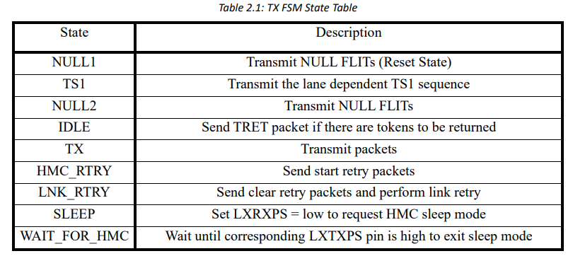
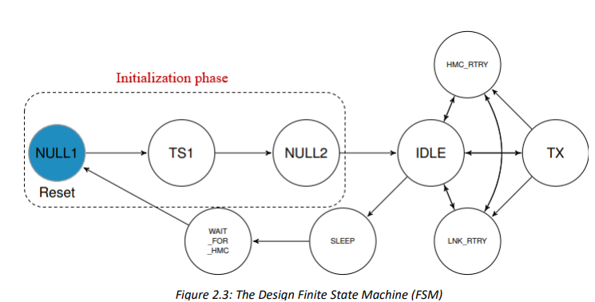
Module Description: TX Link
3- RTL design
3/12
FSM.

Slide 35
Module Description: RX Link
3- RTL design
3/12
FSM:
HMC Down.
HMC wait for NULL.
HMC NULL.
HMC TS1 part Align.
HMC TS1 find ref.
HMC TS1 align.
HMC NULL Next.
HMC Up.

Slide 36
Content
1- Introduction
2- HMC Architecture & Specs
3- RTL design
4- Verification Plan
5- Testbench Architecture
6- RF Agent
7- AXI Agent
8- HMC Agent
9- Scoreboard
10- Coverage
11- Simulation & Results
12- Conclusion

Slide 37

Verification Plan sheets
4- verification Plan
4/12
Design requirement.
system sheet.
Interfaces sheet.
Generation sheet.
Checking sheet.
Test list sheet.
Rf map sheet.

Slide 38
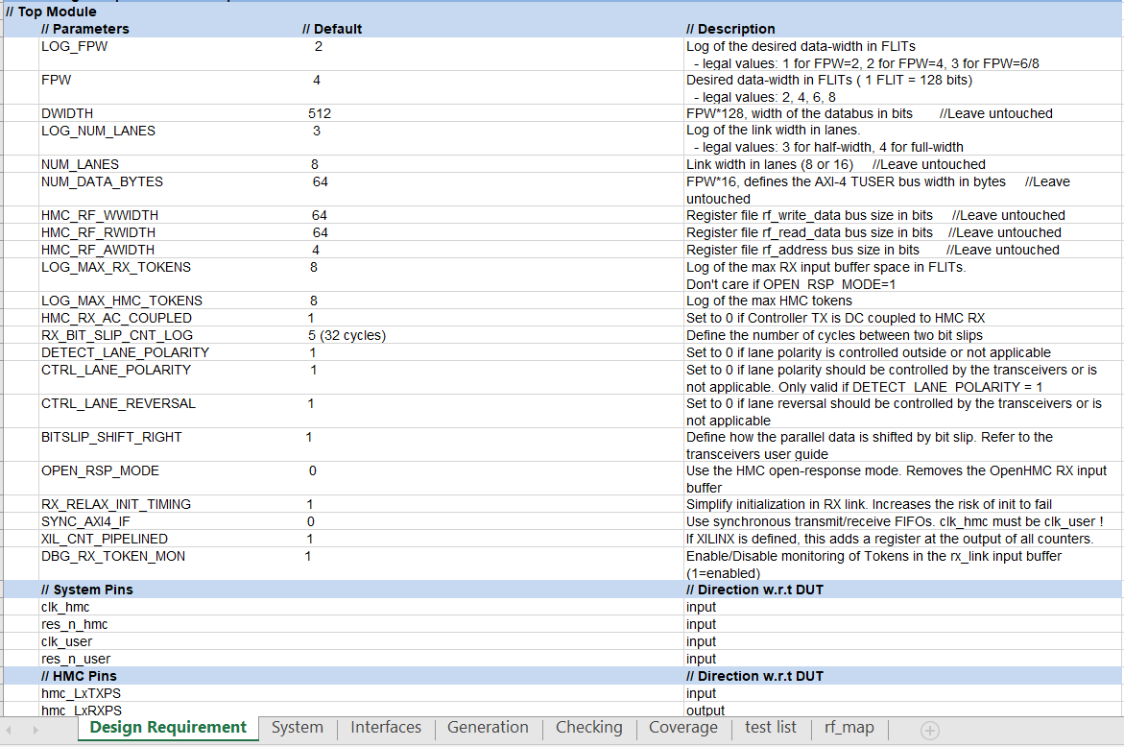

Design Requirements
4- verification Plan
4/12
This sheet contains
the features of the
design specs.

Slide 39
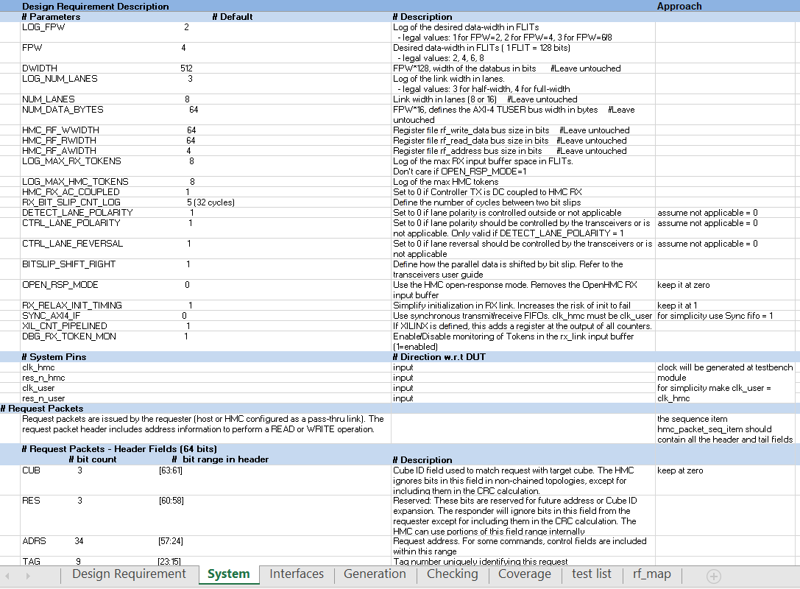
System Sheet
4- verification Plan
4/12
This sheet contains
Approach.

Slide 40
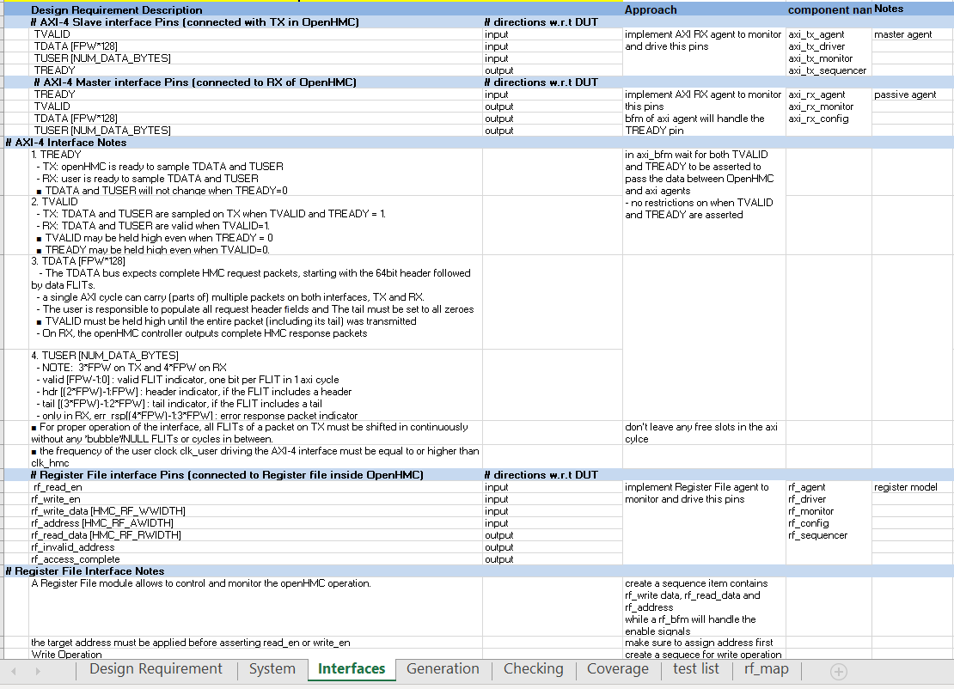
Interfaces Sheet
4- verification Plan
4/12
This sheet contains
Approach.
Component name.
Notes.

Slide 41
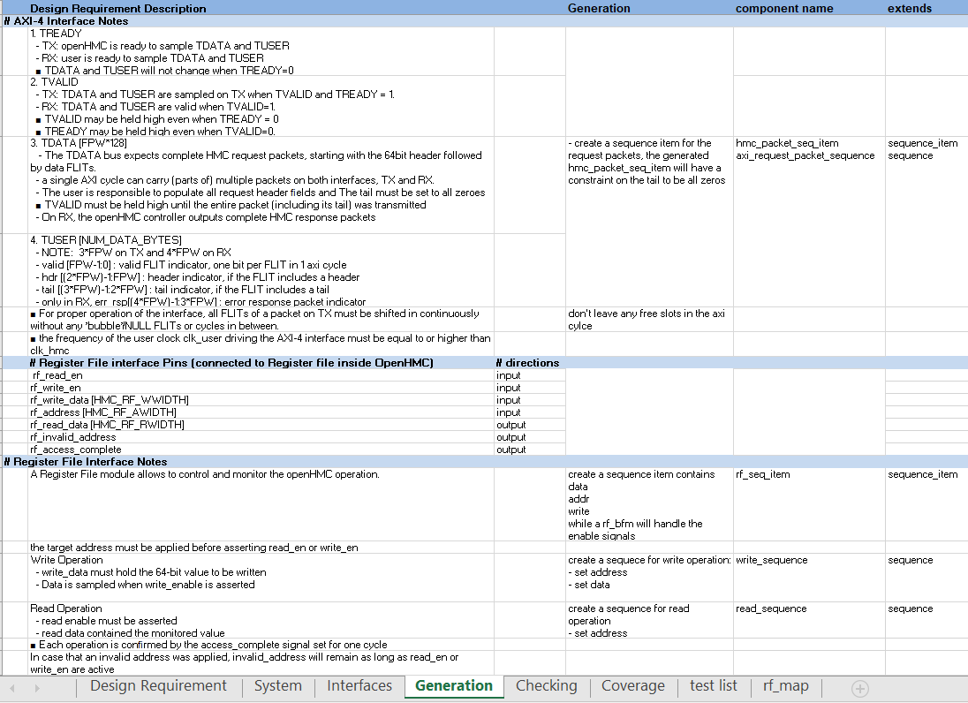
Generation Sheet
4- verification Plan
4/12
This sheet contains
Generation.
Component name.
Extends.

Slide 42
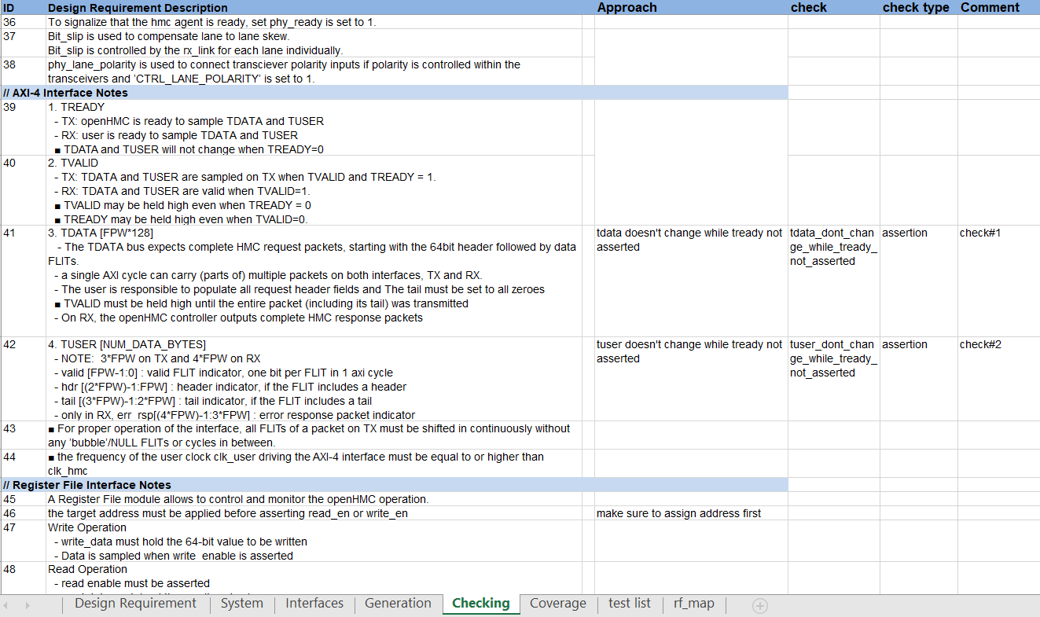
Checking Sheet
4- verification Plan
4/12
This sheet contains
Approach.
Check.
Check type.
Comment.

Slide 43
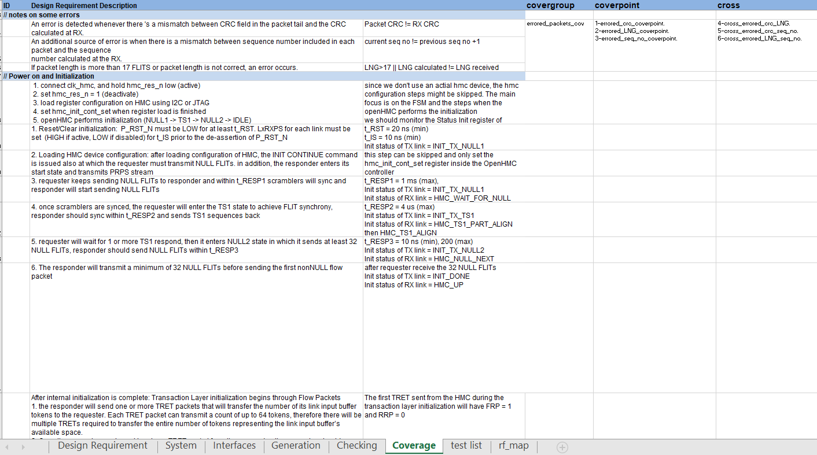
Coverage Sheet
4- verification Plan
4/12
This sheet contains
Covergroup.
Coverpoint.
Cross.

Slide 44
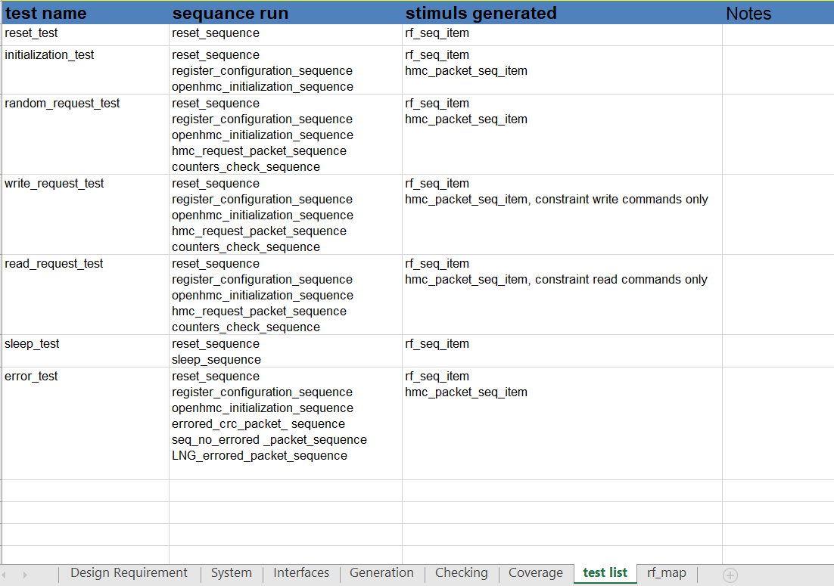
Test List Sheet
4- verification Plan
4/12
This sheet contains
Test name.
Sequence run.
Stimulus generated.
Notes.

Slide 45
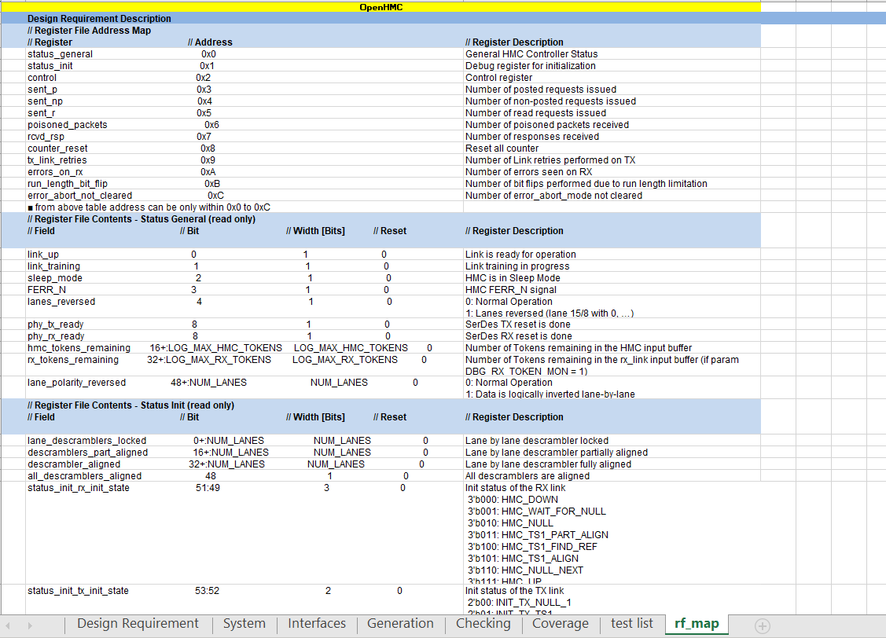
RF Map Sheet
4- verification Plan
4/12
This sheet contains
the register file address map and its contents.

Slide 46
Content
1- Introduction
2- HMC Architecture & Specs
3- RTL design
4- Verification Plan
5- Testbench Architecture
6- RF Agent
7- AXI Agent
8- HMC Agent
9- Scoreboard
10- Coverage
11- Simulation & Results
12- Conclusion

Slide 47
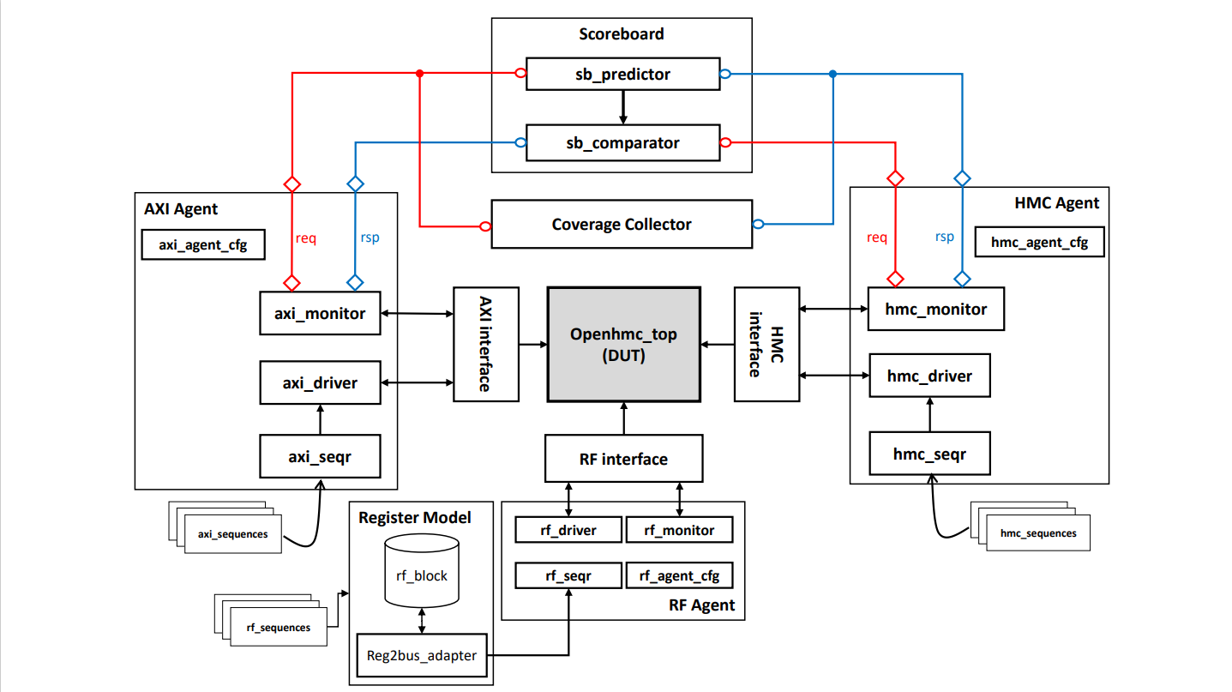
Testbench Architecture
5- Testbench Architecture
5/12

Slide 48
Main Code Files
5- Testbench Architecture
5/12
tb_top module
Import all testbench packages.
Instantiation of all the interfaces and the design top module.
Bind assertions file.
Generation of the clock.

Slide 49
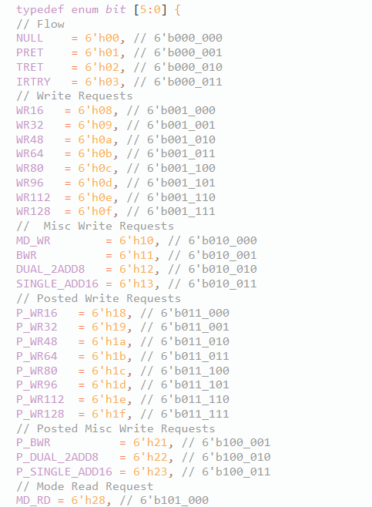
Main Code Files
5- Testbench Architecture
5/12
Packages
cmd_pkg
axi_pkg
hmc_agent_pkg
rf_reg_block_pkg
rf_agent_pkg
tb_params_pkg
Packages
cmd_pkg
axi_pkg
hmc_agent_pkg
rf_reg_block_pkg
rf_agent_pkg
tb_params_pkg
seq_pkg
test_pkg

Slide 50
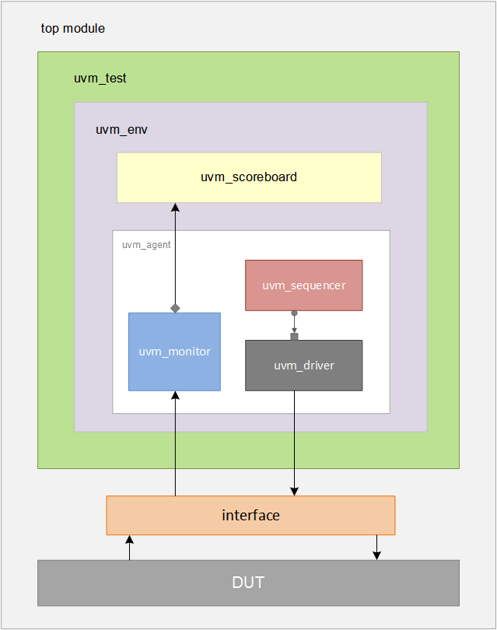
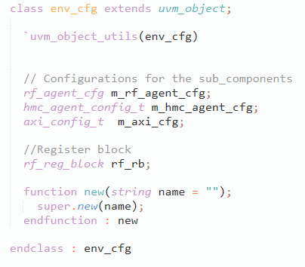
Main Code Files
5- Testbench Architecture
5/12
Environment
Configuration Class
System Interface

Slide 51
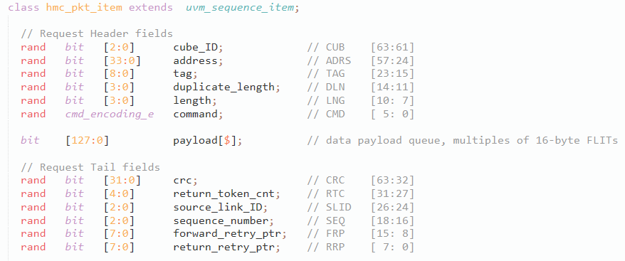
Main Code Files
5- Testbench Architecture
5/12
hmc_pkt_item class
Define packet fields
Set constraints regarding each field
Pack and unpack functions
CRC calculation

Slide 52
Main Code Files
5- Testbench Architecture
5/12
Other Interfaces and Agents
AXI-Agent
RF-Agent
HMC-Agent

Slide 53
Content
1- Introduction
2- HMC Architecture & Specs
3- RTL design
4- Verification Plan
5- Testbench Architecture
6- RF Agent
7- AXI Agent
8- HMC Agent
9- Scoreboard
10- Coverage
11- Simulation & Results
12- Conclusion

Slide 54
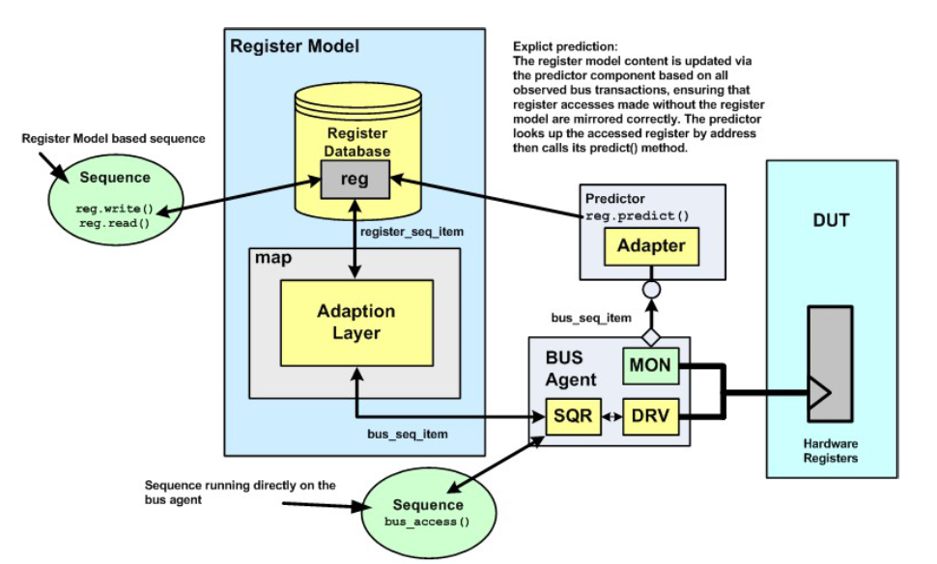
Method of Implementation
6- RF Agent
6/12
Build a register model that maps all the DUT’s registers
Separate class for each register
Group the registers into a register block
Create an adapter as a bridge between the agent and RF model
Common method called “RAL” in UVM cookbook

Slide 55
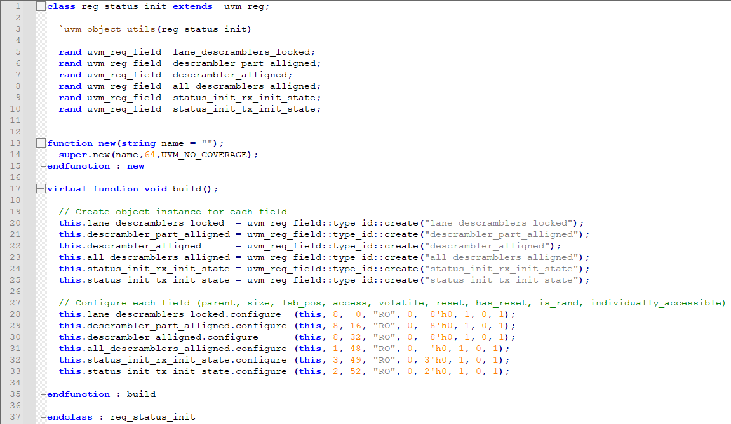
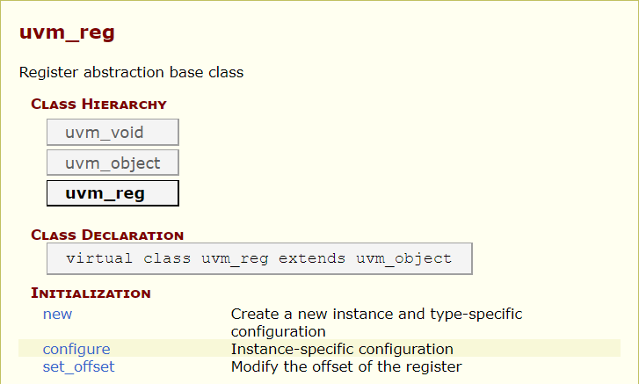
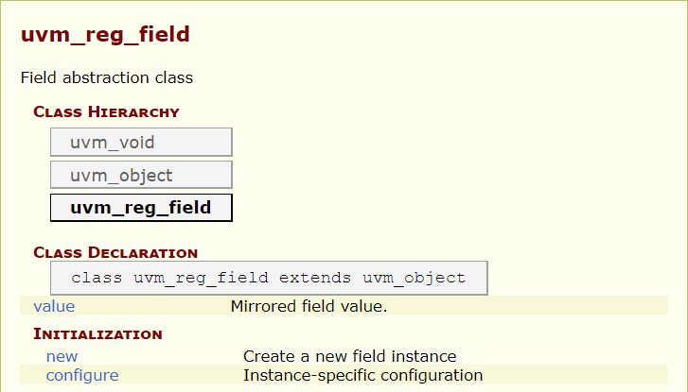
Registers
6- RF Agent
6/12
UVM already has built-in classes
uvm_reg
uvm_reg_field

Slide 56



Register Block
6- RF Agent
6/12
uvm_reg_block
And a uvm_reg_map

Slide 57


Adapter
6- RF Agent
6/12
Convert from the uvm register sequence item into the item used to communication with the interface
Extends from uvm_reg_adapter

Slide 58


Interface Assertions
6- RF Agent
6/12
Written 4 concurrent assertions
Assertion Name | Explanation
no_simultaneous_read_and_write | As stated in the design documentation, the read enable and write enable signals must not be asserted at the same time, so the register file accepts only 1 operation at a time to access it. Either read or write
invalid_address_assert_if_wrong_write_operation | Inside of it written all the addresses that its registers are read-only, so if write enable signal is asserted with these registers’ addresses the invalid address signal should be asserted
invalid_address_assert_if_wrong_read_operation | Same as above but for the 1 register that is write only
access_complete_one_cycle_after_operation | By testing and as shown in the design documentation, access complete signal is always asserted after 1 clock cycle of asserting read or write enable

Slide 59





Bad Documentation
6- RF Agent
6/12
2 of the registers’ description in the design documentation is different from how they are implemented in the RTL
Control Register
Counter Reset

Slide 60
Sequences
6- RF Agent
6/12
Initialization sequence
Sleep sequence
Wrong operations sequence
Read and reset sequences

Slide 61



Initialization Sequence
6- RF Agent
6/12
Configure the DUT
Wait for rx ready
Wait for link up

Slide 62




Sleep Sequence
6- RF Agent
6/12
Implemented to cover a certain scenario in the DUT
Will lower the LxRXPS pin then the other side will also enter sleep mode and lower LxTXPS
Then exit sleep by lowering set_hmc_sleep and then the DUT assert LxRXPS and wait for the other side to assert LxTXPS
Means it will enter the WAIT_FOR_HMC state

Slide 63
Content
1- Introduction
2- HMC Architecture & Specs
3- RTL design
4- Verification Plan
5- Testbench Architecture
6- RF Agent
7- AXI Agent
8- HMC Agent
9- Scoreboard
10- Coverage
11- Simulation & Results
12- Conclusion

Slide 64

AXI agent architecture
7- AXI Agent
7/12

Slide 65

AXI Interface
7- AXI Agent
7/12

Slide 66

hmc_pkt_item_request
7- AXI Agent
7/12

Slide 67

valid_data
7- AXI Agent
7/12
Encapsulates two signals:
It is the sequence item that the sequencer sends to the driver.

Slide 68

Driver
7- AXI Agent
7/12
Drives the signals to the DUT via the interface.

Slide 69
Sequence
7- AXI Agent
7/12
Generate request packets of type hmc_pkt_item_request
Assign tags to the packets
Divide the packets to flits
Create a valid_data item and arrange the flits to form TDATA with maximum 4 flits and assign TUSER
Send the valid_data items to the sequencer

Slide 70

Monitor
7- AXI Agent
7/12
request analysis port
response analysis port

Slide 71
Content
1- Introduction
2- HMC Architecture & Specs
3- RTL design
4- Verification Plan
5- Testbench Architecture
6- RF Agent
7- AXI Agent
8- HMC Agent
9- Scoreboard
10- Coverage
11- Simulation & Results
12- Conclusion

Slide 72
HMC Agent
8- HMC Agent
8/12
Reactive agent.
Has 3 components:
Driver.
Monitor.
Sequencer.
2 Stages.
Initialization
Stage
Request/Response
Stage

Slide 73

Initialization Stage: Driver
8- HMC Agent
8/12
TX and RX state in the DUT.
packing_FLITS() function.
NULL State.
TS1 State.

Slide 74
Initialization Stage: Monitor
8- HMC Agent
8/12
“notify_req_transaction” function.
“notify_res_transaction” function.

Slide 75

Initialization Stage: Sequences
8- HMC Agent
8/12
hmc_init_vseq.
hmc_state_seq.
hmc_initialization_seq.

Slide 76



Request/Response Stage: Driver
8- HMC Agent
8/12
“write_request” function & “request_queue”.
link_status class.
“link_up” function.
“get_packets” function.
“get_response” function.

Slide 77
Content
1- Introduction
2- HMC Architecture & Specs
3- RTL design
4- Verification Plan
5- Testbench Architecture
6- RF Agent
7- AXI Agent
8- HMC Agent
9- Scoreboard
10- Coverage
11- Simulation & Results
12- Conclusion

Slide 78

Scoreboard
9- Scoreboard
9/12
A UVM scoreboard receives transactions from a monitor
Predicts what DUT outputs should occur based on DUT inputs
Receives transactions containing the values driven into the DUT.
Calculates what the DUT outputs should be for those inputs.
Stores the predicted results until the actual DUT outputs are available.

Slide 79
Scoreboard
9- Scoreboard
9/12
Receives transactions containing the values of the actual outputs.
Compares the actual outputs to the predicted outputs.

Slide 80

Scoreboard goals
9- Scoreboard
9/12
We check that if :
the received packet is the transmitted packet
the response packet is the expected response packet
of the request packet.

Slide 81


Scoreboard functions
9- Scoreboard
9/12

Slide 82
report phase
9- Scoreboard
9/12
finally report
the result of comparison to know that where the error has happened
Number of axi4_req_packet.
Number of axi4_rsp_packet.
Number of hmc_req_packet.
Number of hmc_rsp_packet.
Number of error_response.

Slide 83
Content
1- Introduction
2- HMC Architecture & Specs
3- RTL design
4- Verification Plan
5- Testbench Architecture
6- RF Agent
7- AXI Agent
8- HMC Agent
9- Scoreboard
10- Coverage
11- Simulation & Results
12- Conclusion

Slide 84

Coverage
10-Coverage
10/12
Coverage Measure verification progress
Types of coverage :
code coverage.
Functional coverage.

Slide 85
code coverage
10-Coverage
10/12
Automatically extracted from design code.
measures how much of the design code is exercised.
Tool generated.
usually used to identify holes in the verification that has been performed.
Sometimes called structural coverage.

Slide 86
code coverage
10-Coverage
10/12
Has many types
Code coverage
Statement coverage
Expression coverage
FSM coverage

Slide 87

10-Coverage
10/12
code coverage
Statement coverage
Statement coverage can also be
called block coverage or line
coverage ,where a block is
a sequences of statements that
are executed if a single statement
is executed .

Slide 88

code coverage
10-Coverage
10/12
Expression coverage
Expression coverage measures the
various way decisions through the code.

Slide 89

code coverage
10-Coverage
10/12
FSM coverage
FSM coverage has two types :
State coverage:
Which states have been visited.
Transition coverage:
did all possible transition happen.

Slide 90
what Dose 100 percent code coverage mean ??
10-Coverage
10/12
The entire design implementation was executed.
It does not provide an indication about the correctness of the verification suite.
That doesn’t mean the design is complete.
what if the designer forget to implement a feature from the specs? would code coverage be affected?
We need Functional coverage.

Slide 91
Functional coverage
10-Coverage
10/12
Written according to feature from the specs.
Functional coverage is another technology to help ensure that a bad design is not hiding behind passing testbenches. (design tested well.)
Functional coverage records relevant metrics (packet length, instruction op_code, buffer occupancy level , e.g.) to ensure that the verification process has exercised the design through all of the interesting values.

Slide 92
Functional VS code coverage
10-Coverage
10/12
Code coverage measures how much of the implementation has been exercised, Functional coverage measures how much of the original design specification has been exercised.
High functional coverage does not necessarily correlated with high code coverage.

Slide 93

Functional VS code coverage
10-Coverage
10/12

Slide 94
Functional coverage
10-Coverage
10/12
Covergroup
The covergroup construct encapsulate the specification of a coverage model. Each covergroup specification can include the following components:
A clocking event that synchronizes the sampling of the coverage points.
A set of coverage points .
Cross coverage between coverage points .

Slide 95
cross coverage points
10-Coverage
10/12
cross coverage is specified between the cover points or variables. Cross coverage is specified using the cross construct.
Expression cannot be used directly in a cross, a coverage point must be explicitly defined first .

Slide 96
Content
1- Introduction
2- HMC Architecture & Specs
3- RTL design
4- Verification Plan
5- Testbench Architecture
6- RF Agent
7- AXI Agent
8- HMC Agent
9- Scoreboard
10- Coverage
11- Simulation & Results
12- Conclusion

Slide 97

Tools
11- Simulation and Results
11/12
Ran the simulations on Questasim v2021.1

Slide 98
Tests
11- Simulation and Results
11/12
Simple test
Tests with more constraints
Test to hit HMC_RTRY state
Reset tests

Slide 99

Simple Test
11- Simulation and Results
11/12
First test to try
Usual sequence of operations then enter and exit sleep mode

Slide 100




Simple Test Results
11- Simulation and Results
11/12
Functional Coverage
Code Coverage
FSM Coverage
3 FSMs, 19 states and 37 transitions

Slide 101



Simple Test Results
11- Simulation and Results
11/12
FSM Coverage
State
TX init
RX init
These results gave us motive to test the messing scenarios in the FSMs

Slide 102


Results
11- Simulation and Results
11/12
Tested Features
Tested Configurations
Features | Tested
Full link-training, sleep mode and link retraining
16Byte up to 128Byte read and write (posted and non-posted) transactions
Posted and non-posted bit-write and atomic requests
Mode read and write
Error response
Full packet ﬂow control
Packet integrity checks (sequence number, packet length, CRC)
Fully automatic error handling and link retry
Control and detect lane reversal and lane polarity
AXI Interface Configurations | Tested
2 FLITs per Word / 256-bit Datapath
4 FLITs per Word / 512-bit Datapath
6 FLITs per Word / 768-bit Datapath
8 FLITs per Word / 1024-bit Datapath

Slide 103



Results
11- Simulation and Results
11/12
Functional Coverage
Code Coverage
Assertions

Slide 104



Results
11- Simulation and Results
11/12
FSM Coverage
State
TX init
RX init

Slide 105
Content
1- Introduction
2- HMC Architecture & Specs
3- RTL design
4- Verification Plan
5- Testbench Architecture
6- RF Agent
7- AXI Agent
8- HMC Agent
9- Scoreboard
10- Coverage
11- Simulation & Results
12- Conclusion

Slide 106
Conclusion
12- Conclusion
12/12
Learned Points.
Faced Problems.
Advices and Future Work.

Slide 107




12- Conclusion
12/12
1.Learned lessons
self-learning that we don’t specifically need an instructor
Learned
lessons
Learned System Verilog ,UVM, functional verification.
>ALU before starting on our graduation project.
>(Questasim) and write its scripts.
Faced compilation and simulation errors ,that we learned to search for solutions .

Slide 108
2.Faced Problems
12- Conclusion
12/12
aspects of the design hard to understand as the whole design was explained in about 16 papers only.
graduated engineers advice us to search for online resources,
the problem was the only source was the specs document.
2. the verification plan took long time period because of the lack of example

Slide 109
2.Faced Problems
12- Conclusion
12/12
Company tool
moveing files from our devices to the virtual machine was closed.
copy and paste text was also closed.
So, if we use this tool we must create new files inside the virtual machine and write all the RTL codes and our Testbench codes.
No internet connection.
GitHub

Slide 110
3.Advices and Future Work
12- Conclusion
12/12
notes about things we could’ve done through the project
During compilation and simulation, we faced many errors
we solve them and save in excel sheet.
There are many coding and functional verification methods we didn’t try during this project during the lack of time
trace the RTL code and read each statement, branch or condition that we didn’t hit and try to test it with a scenario.
3) adding more tests and covergroups as our design is very simple.

Slide 111


